Slide 1
Arduino Workshop #5
Shift Registers

Slide 2
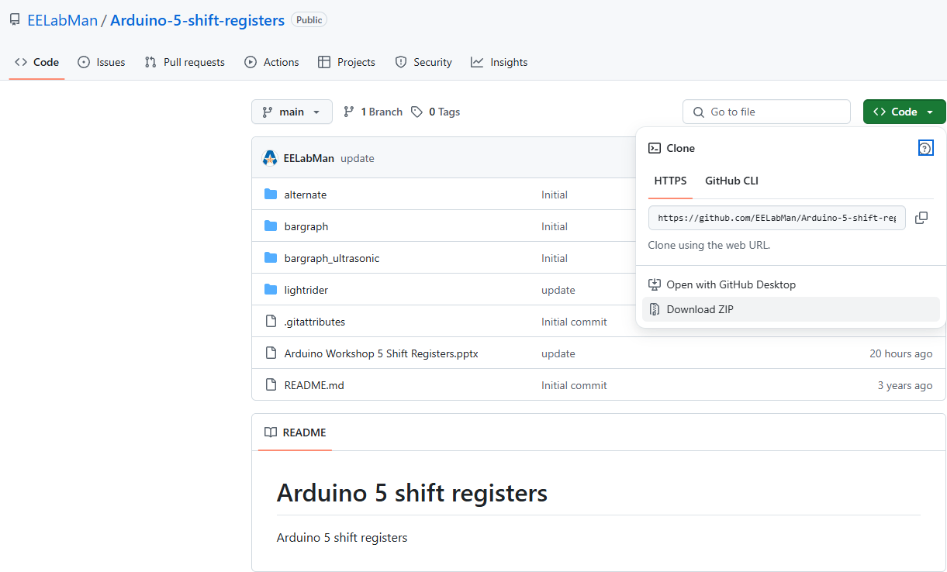
PowerPoint and Code
Click the GREEN code button and download the ZIP folder. BE SURE TO UNZIP THIS FOLDER.

Slide 3
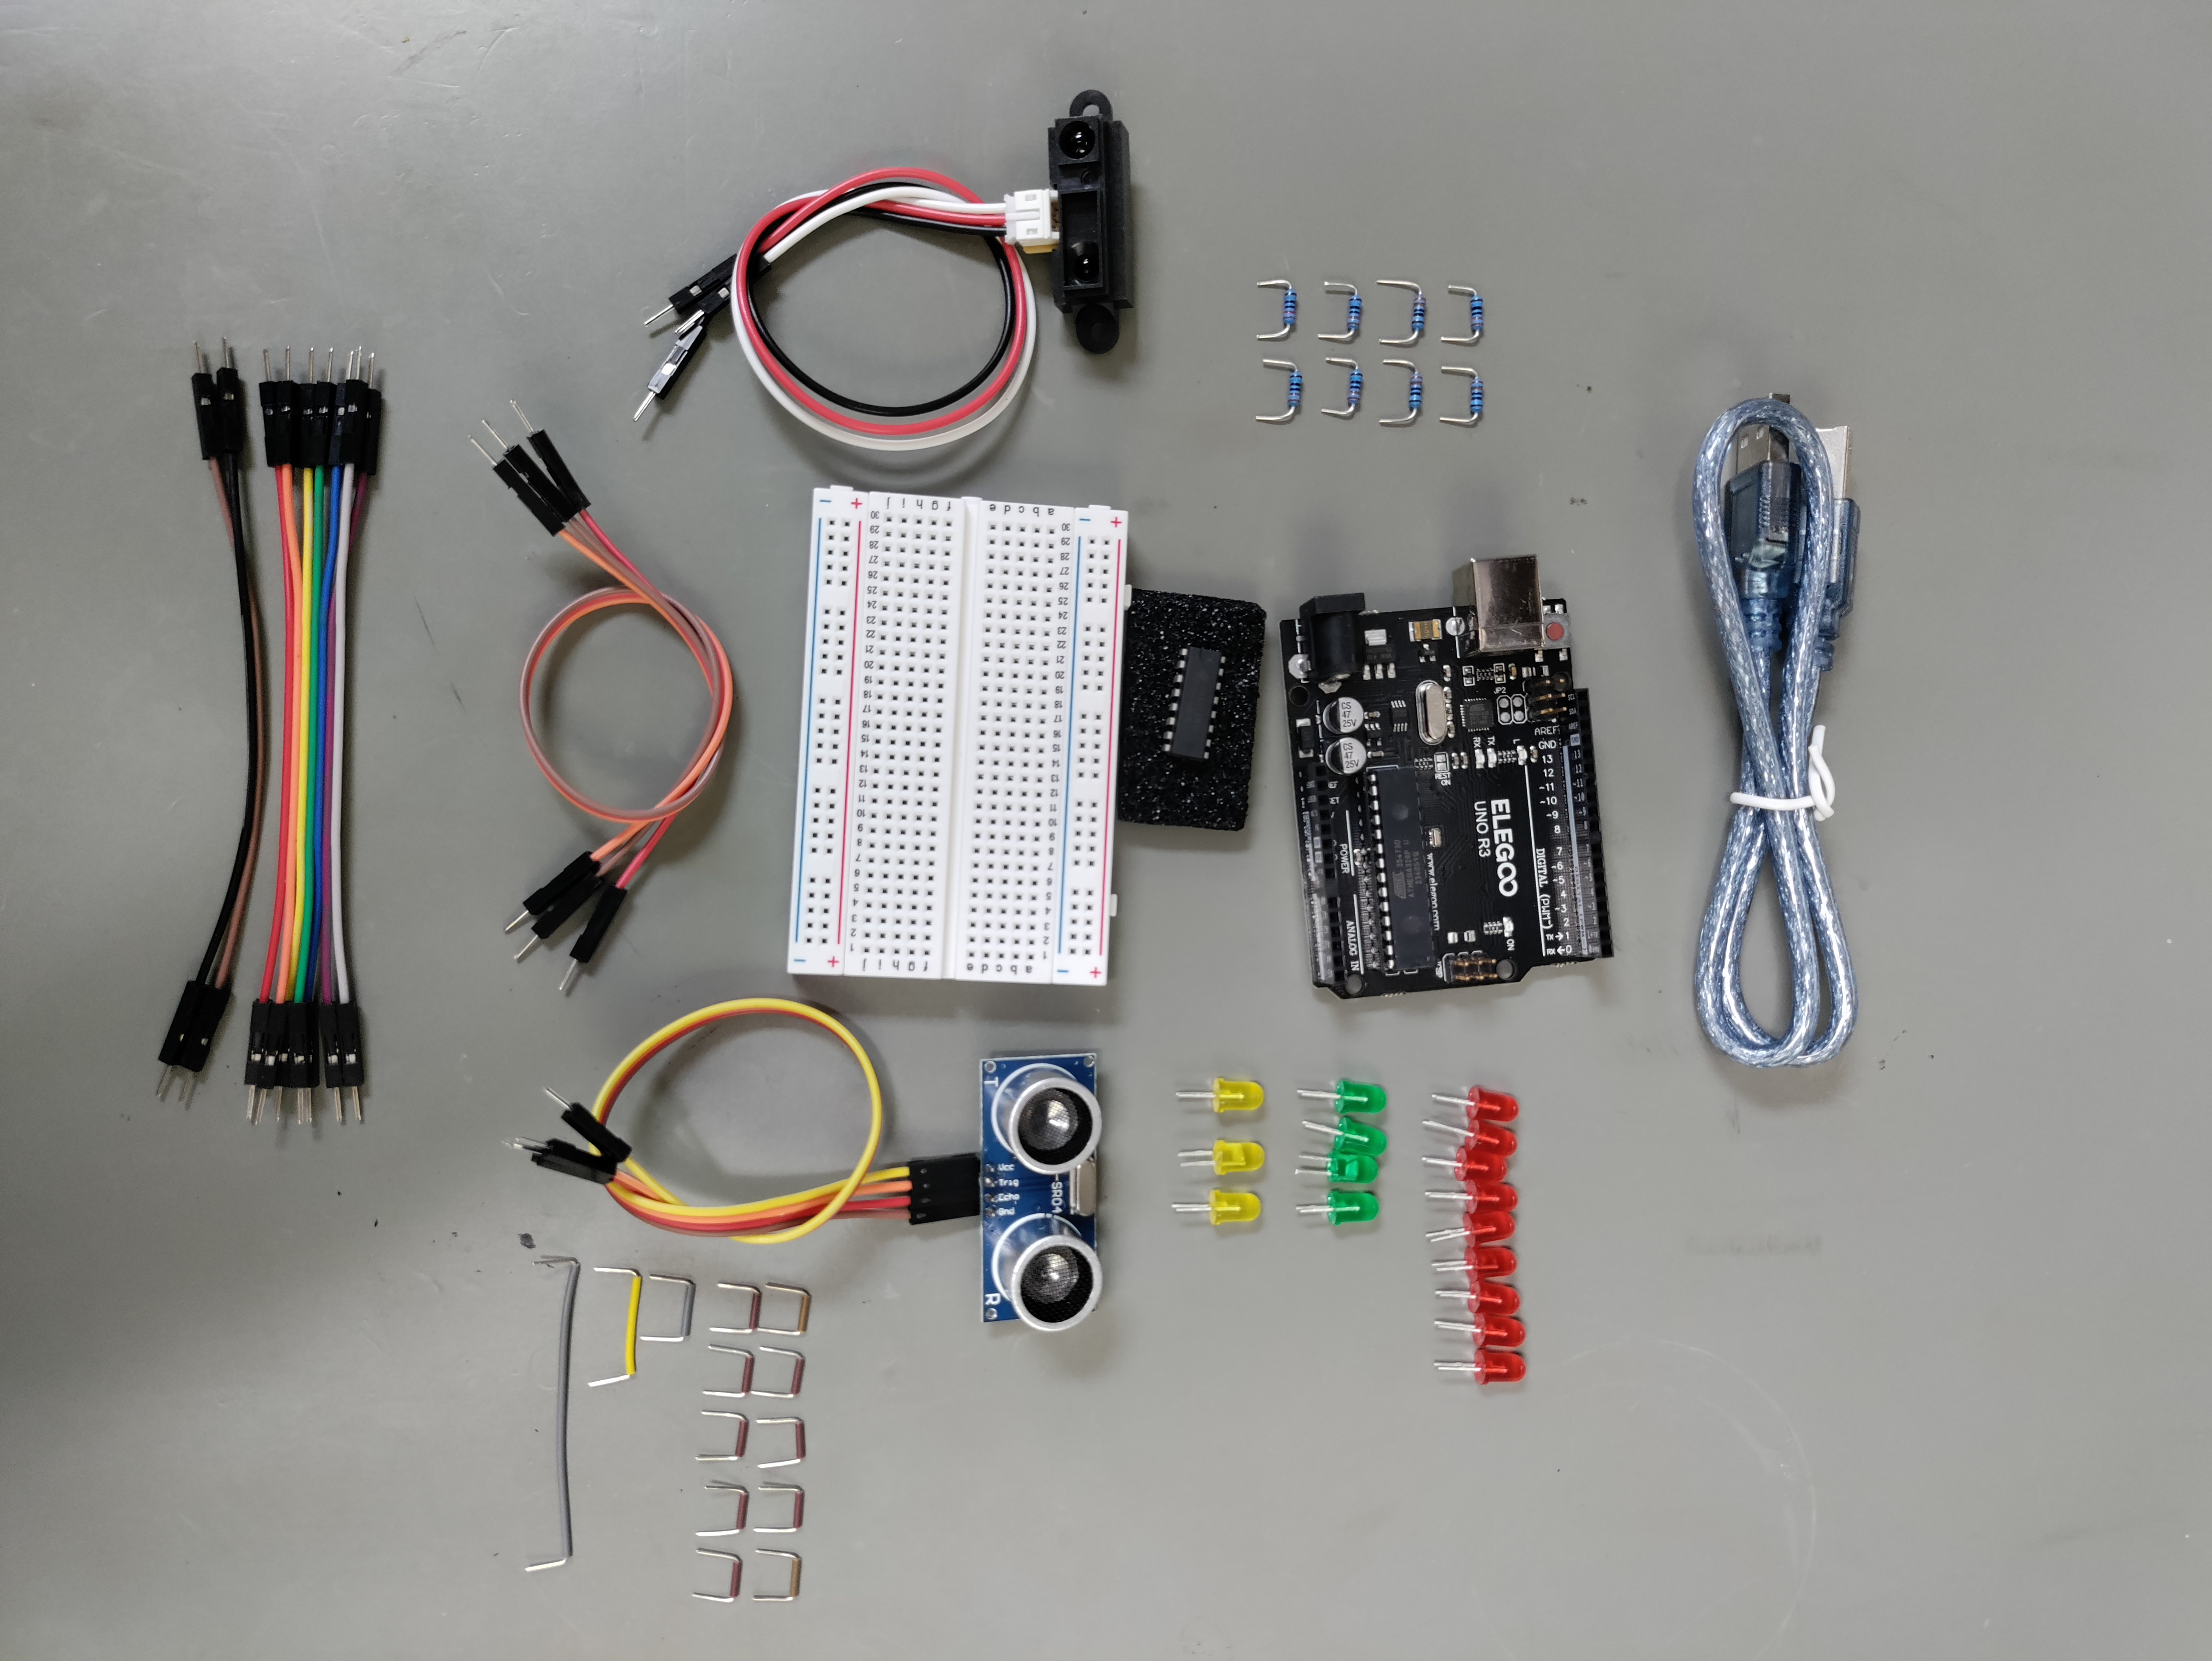
Parts
USB Cable
Arduino Uno
8 - 220Ω
8 – RED LED’s
4 – Green LED’s
74HC595 Shift Register Chip
3 – Yellow LED’s
Ultrasonic Sensor
Sharp IR distance sensor
10 – brown breadboard wires (10mm)
1 – gray breadboard wire
3 long male to male jumpers
1 – yellow breadboard wire
1 – gray breadboard wire (125mm)
9 (7 + 2) short male to male jumpers

Slide 4
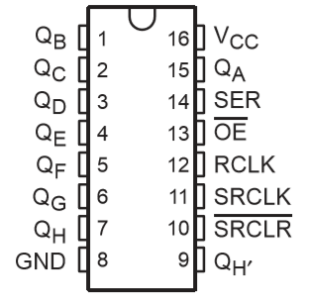
Looking at the 74HC595 Shift register pin-out diagram
Pins Q_{A} to Q_{H}
The eight parallel outputs of the shift register
VCC
Connect to 5 V
GND
Shared ground with the arduino
SER
Where we will feed 8 sequential bits to set the value of the parallel out puts
SRCLK
Clock pin
Every time this is high the value shifts by 1 bit
8 pulses will pull all the data we are sending
RCLK
Latch pin (register clock pin)
Allows to sequentially shift data

Slide 5
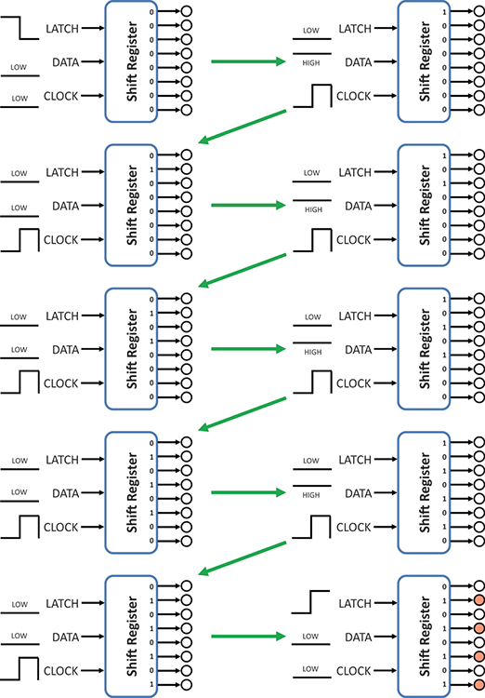
How it works
Send in a serial 10101010

Slide 6
Let's look at the new Arduino code
Conveniently, Arduino has a built in shift function “ shiftOut()”
It accepts 4 parameters
Data pin number
Clock pin number
Bit order
The value to shift out
If for example you want to shift out the alternating pattern shown previously you would write
shiftOut(DATA, CLOCK,MSBFIRST, B10101010);
Data and clock are set to the pin number for those lines
MSBFIRST indicates the most significant bit (leftmost) is sent first
B in the last parameter tells the Arduino IDE to interpret as binary rather than a decimal

Slide 7
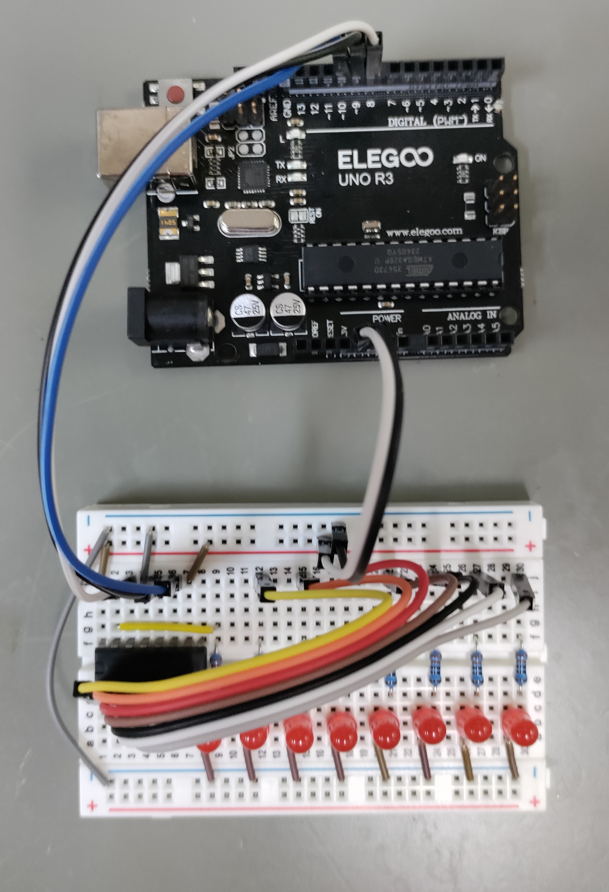
Breadboard Layout
Your finished Breadboard should look like this one.
The diagram is on the next slide for a better view.

Slide 8
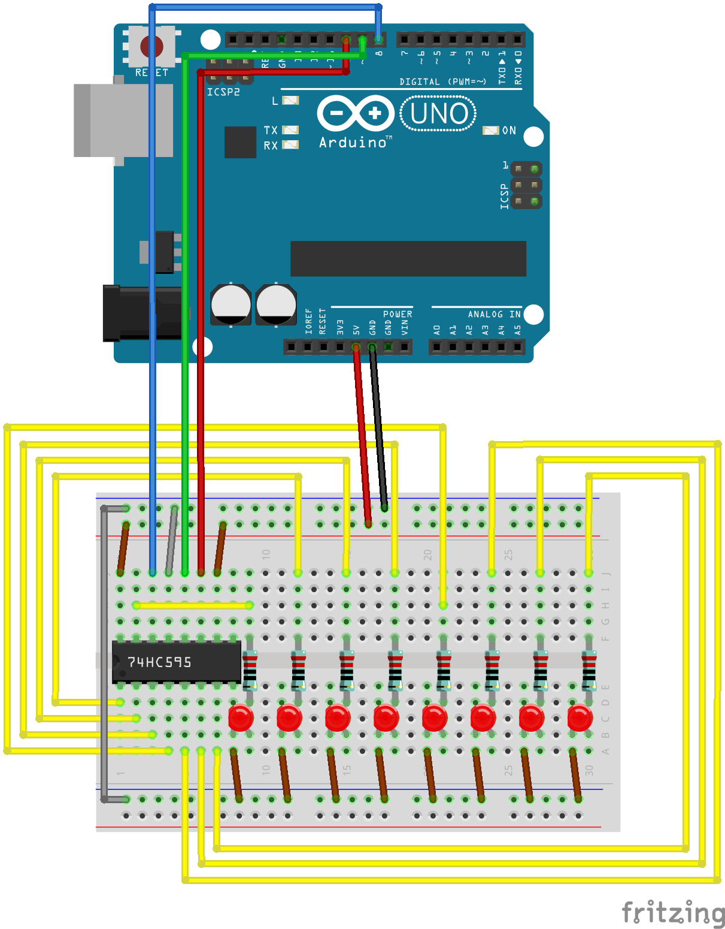
Lets wire it up
Data is pin 8
Latch is pin 9
Clock is pin 10
Flat side of LED is the negative cathode. Cathode is on the left.
Pin 1 of the shift register is in column 1 row E of the breadboard.
Be Exact with placement.

Slide 9
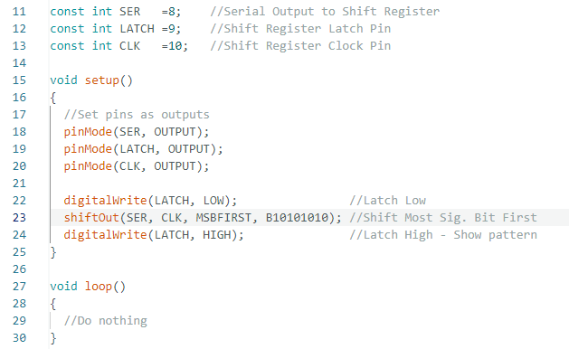
Upload alternate.ino
Because the shift register will latch the values, you only need to send them one time in the setup section of the code.
This program follows the flow chart shown earlier
Latch pin is set low
8 bits of data shifted in (using shiftOut())
Latch pin is set high
Change MSBFIRST to LSBFIRST in line 23 and upload again – what happens?

Slide 10
Animation using shift register
We can make a light rider (leds chase each other back and forth) with the same circuit as before
We will simply change how we implement shiftOut()
Because shiftout() is very fast we can update the register thousands of times per second
We just need to know the binary code we want the leds to follow (and then we need to convert that into a decimal)
Store that as a sequence
Iterate the sequence and use the value as the shift value
For loop works good here

Slide 11
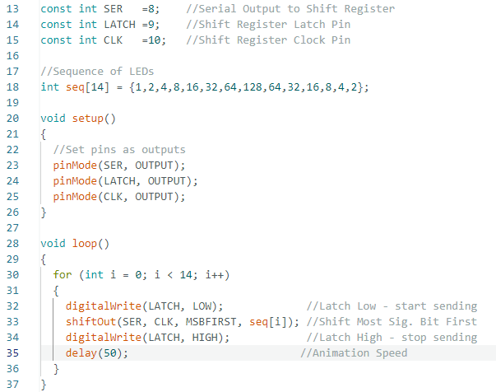
Upload lightrider.ino
Speed the lights up or down by changing the delay.
The index is referenced from 0 to 13 ( 14 numbers )
In binary 1 = 0000001
2 = 0000010
4 = 0000100 and so on to light all 8 LED’s one after another.

Slide 12
LED bar graph

Slide 13
Use our knowledge
Goal:
Make the LED lights respond as a bar graph to how close your hand (or other object is)
Using our knowledge of analog sensors and the shift registry
Using a IR distance sensor to change the registry
We are also going to need to map the receiver values (0 to 500) to 4 bits (0 to 8) range

Slide 14
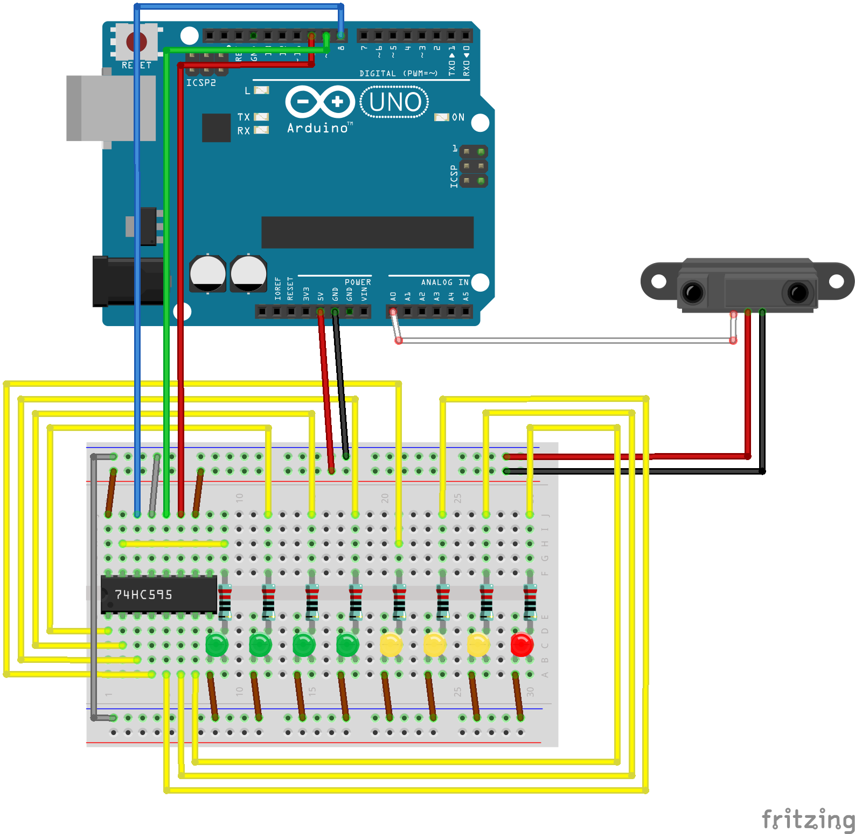
Wire it up
The IR Wires:
Notice the white wire is the output or the sensor.
The Red wire is GROUND!
The Black wire is POWER!

Slide 15
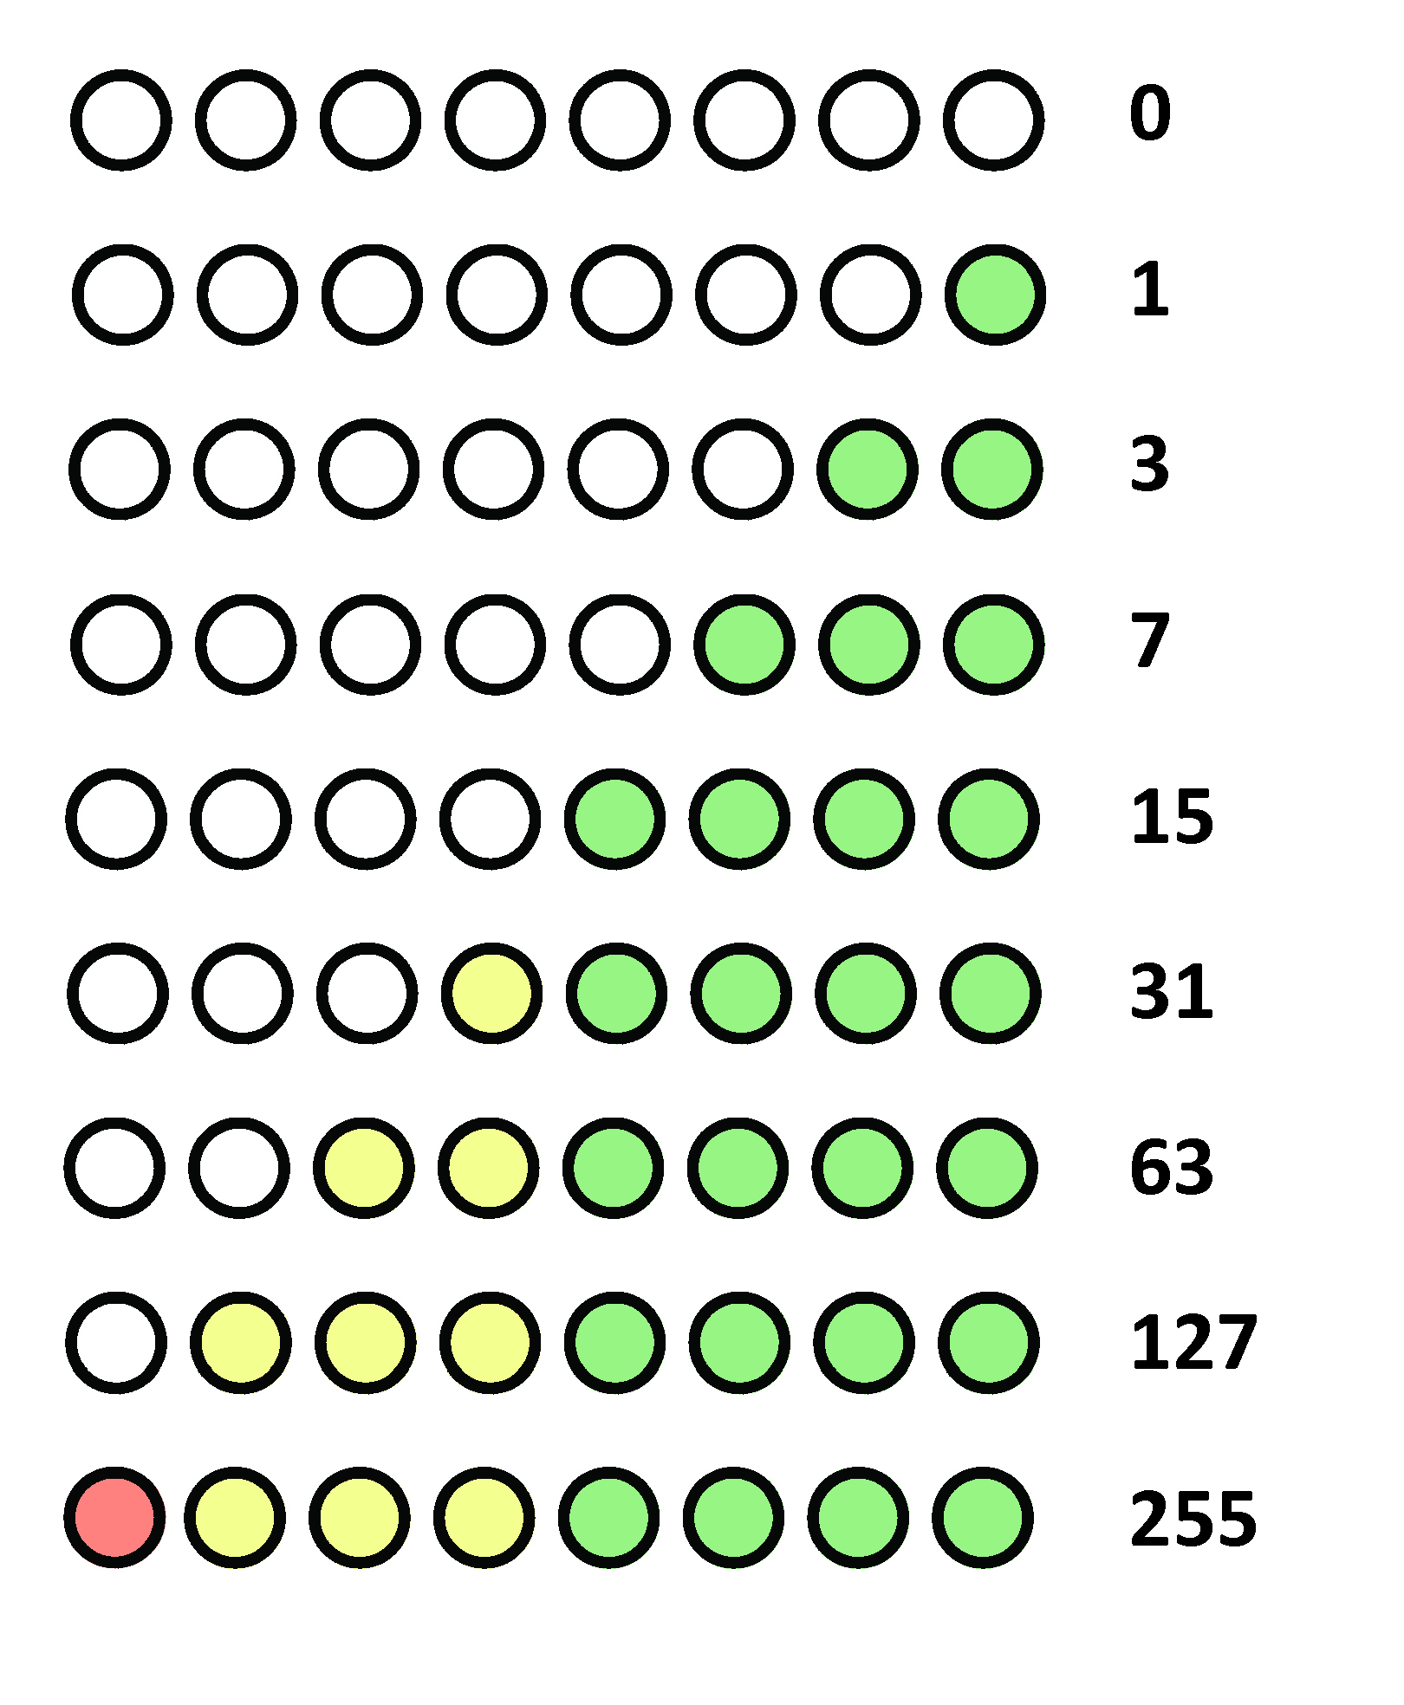
What we want as the result
Where each line is some distance away from the receiver and as we get closer to the receiver more lights light up
Try this first, we will look at one possible solution in a moment
Note the values next to each line is the decimal conversion of the binary shown

Slide 16
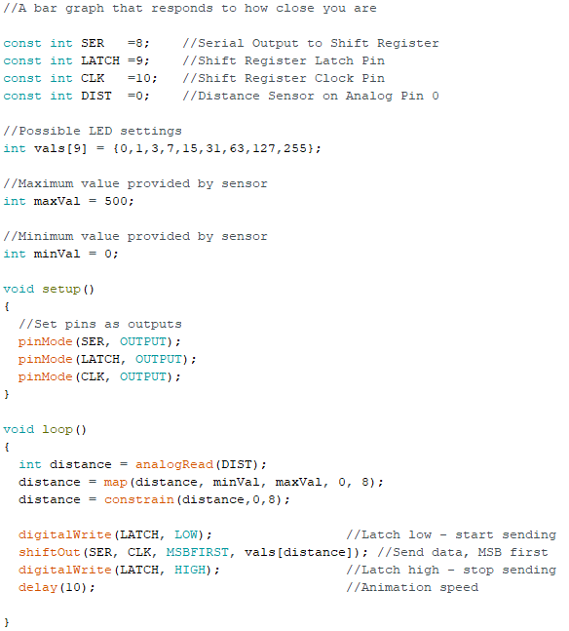
Download bargraph.ino

Slide 17
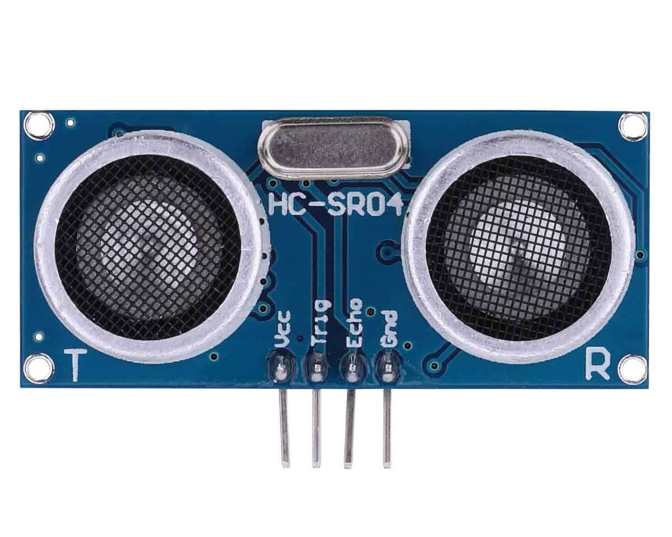
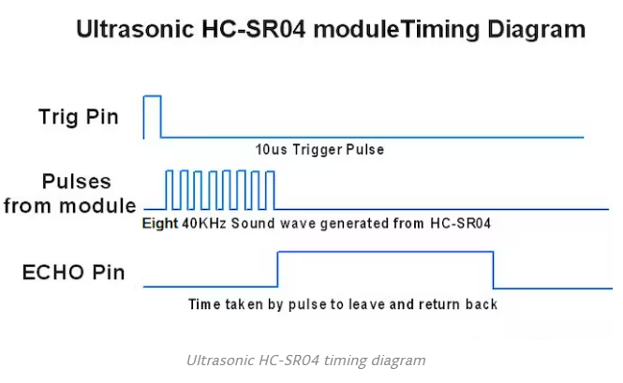
HC-SR04 Ultrasonic Sensor
Using IO trigger for at least 10us high level signal.
The Module automatically sends eight 40 kHz and detects whether there is a pulse signal back.
If the signal returns, the ECHO Pin will pulse its output for the duration it took to receive the signal back. Like a PWM signal.

Slide 18
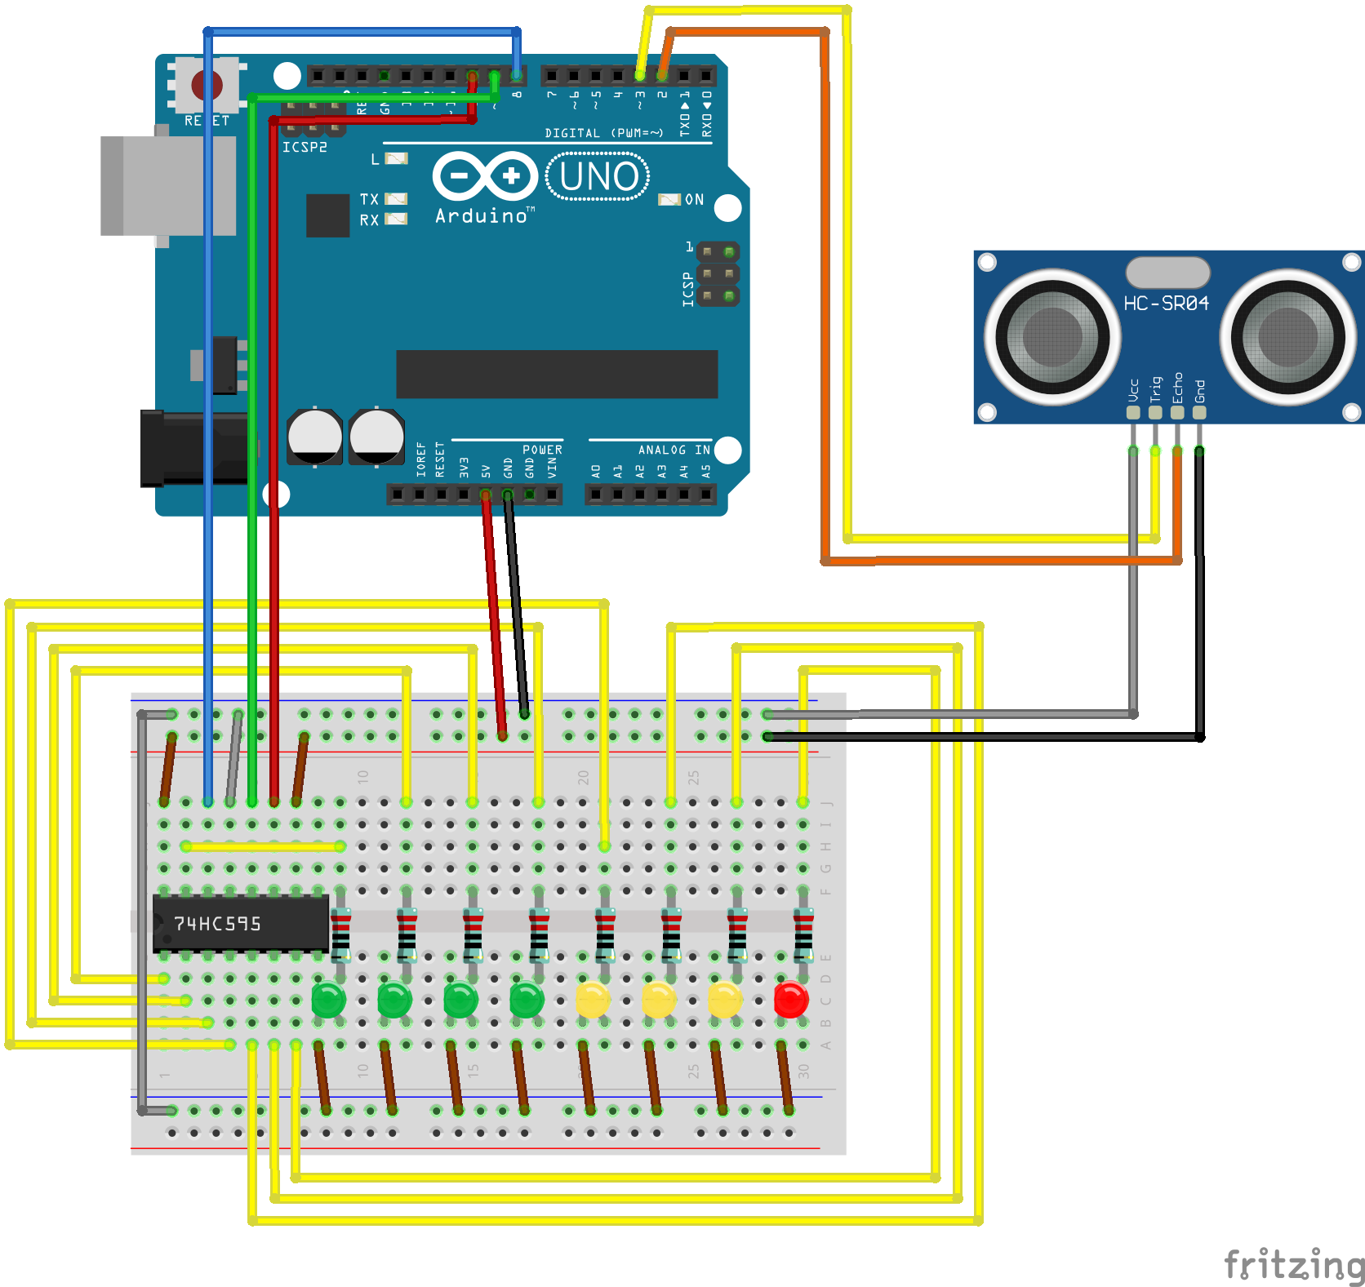
Wire it up
Now with an Ultra Sonic sensor!
Build this circuit then upload
Bargraph_ultrasonic.ino
Read the serial port – bounce waves back with a flat object at different distances.
Change the max value and retest
Male to female jumpers leave these wires attached to the sensor.

Slide 19
Clean up
Disassemble your breadboard and put all parts back in the bag for the next student.
Return the kit to the lab manager.

Slide 20
Stay tuned
Arduino 6 will cover the I²C bus.
We’ll wire a Digital Temperature sensor to the circuit we just built!

